Slide 1

BANKING –
DEPOSITS AND GROWTH

Slide 2

What ways do banks offer to save and grow money?
Savings Account
Our money does not sit idle even in a savings account.
It earns interest
Money that the bank gives a customer for the money he/she keeps with the bank
Fixed Deposit (FD)
A large sum when put in a fixed deposit account, earns higher interest
Recurring Deposit (RD)
Small sums of money put in a recurring deposit account, on a regular basis, earn higher interest than a savings account

Slide 3
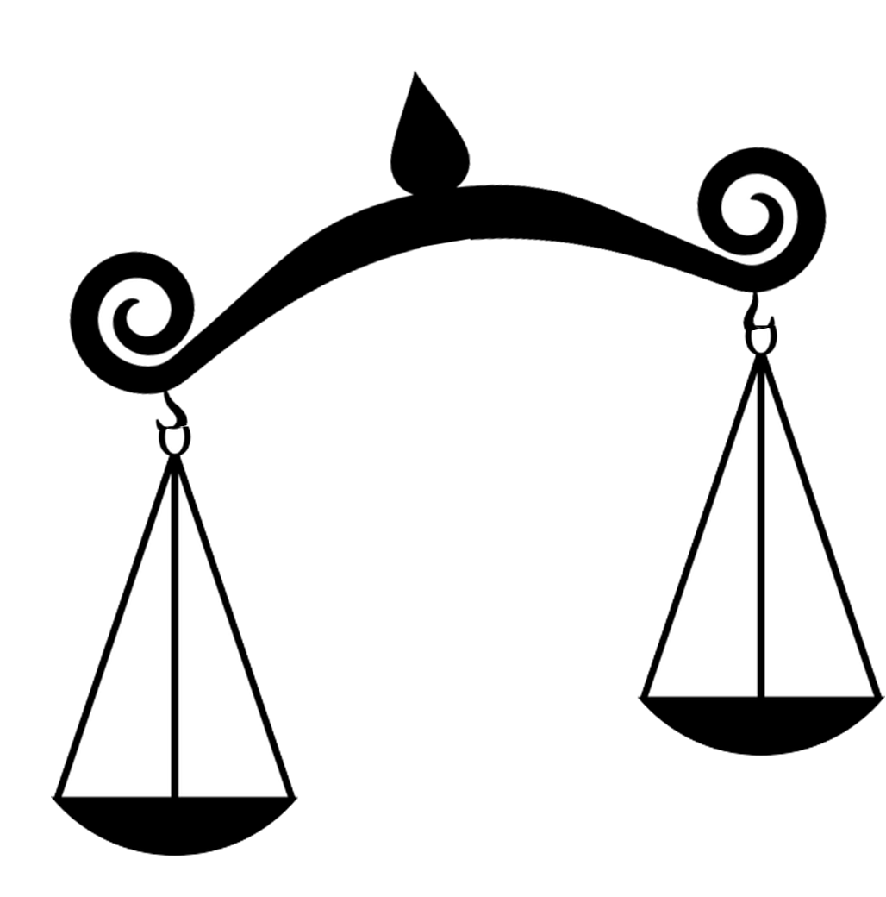
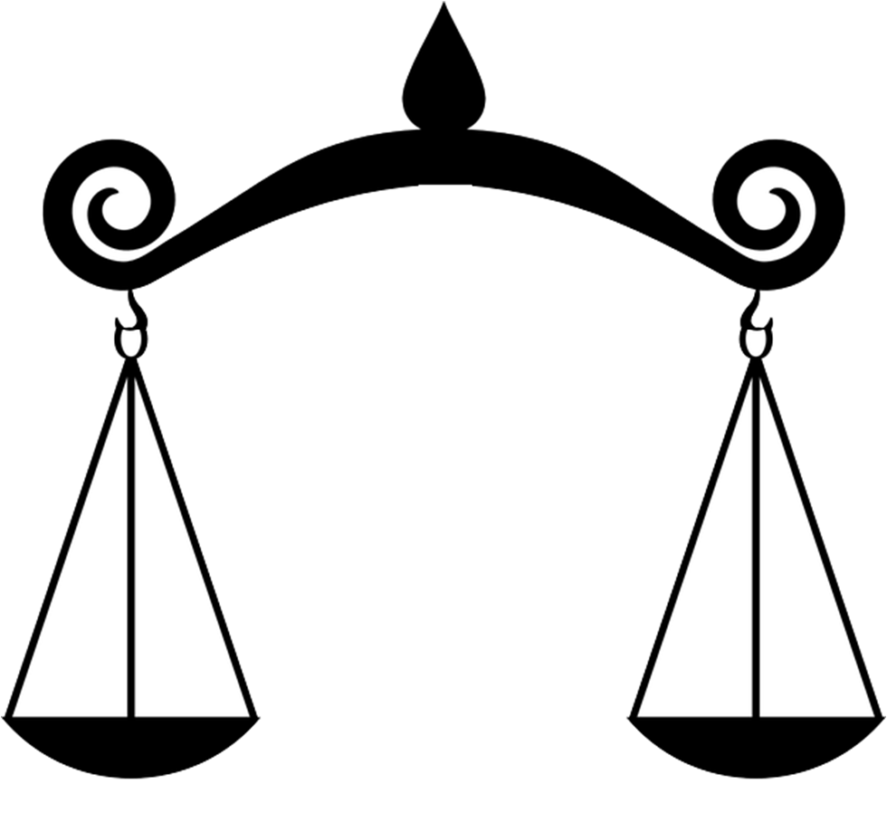

When can I use a Fixed Deposit?
When money earned or collected…
Is more than money spent…
It can be put in a Fixed Deposit with the bank. A Fixed Deposit offers interest when a large sum of money is put into a Fixed Deposit Account
Saving
Spending

Slide 4

When can I use a Fixed Deposit?
I have got a bonus! Should I keep it in a savings account?
A better idea would be to put the sum into a Fixed Deposit account.
It will be locked in for some time but it will earn higher interest than a savings account

Slide 5
After how long can I get money back?
When you put your money in a fixed deposit you have to decide how long you want to leave it there for
This term can be:
From:
7 Days
MTWTFSS
To:
10 Years
2015 2016 2017 2018 2019 2020 2021 2022 2023 2024

Slide 6
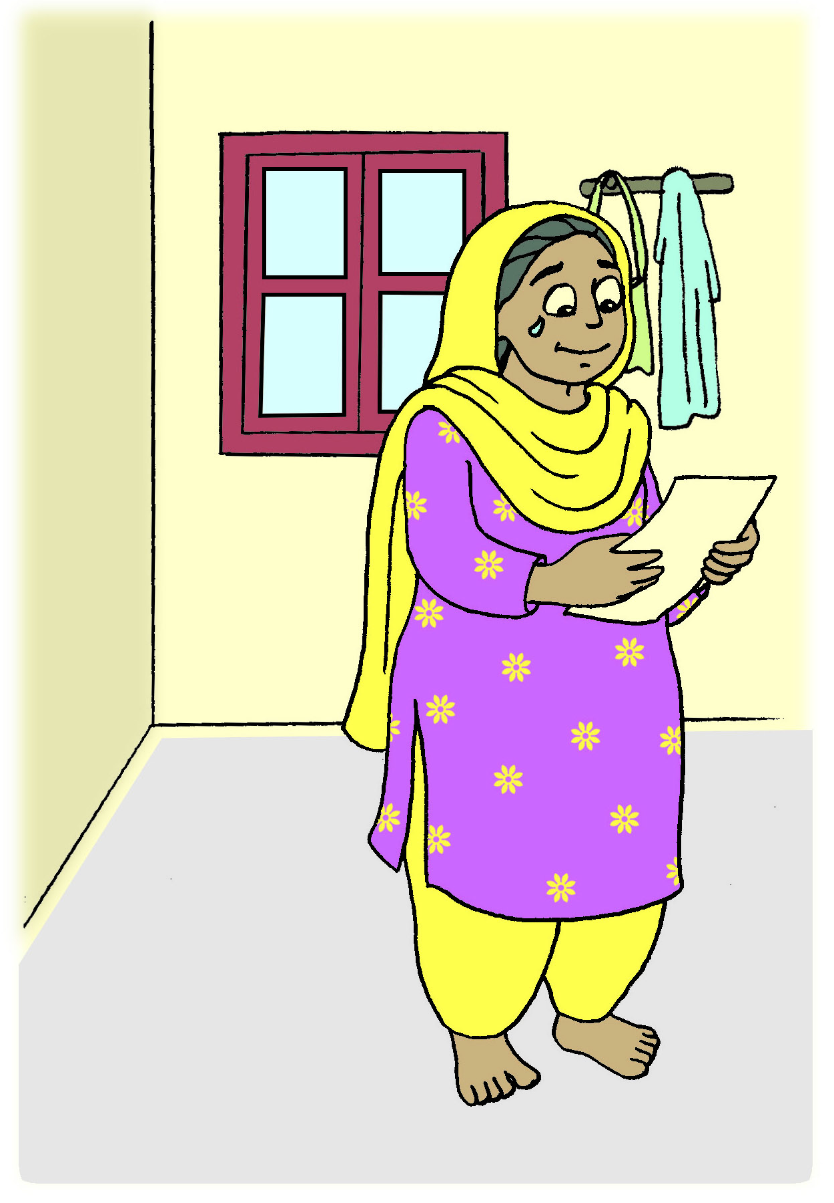
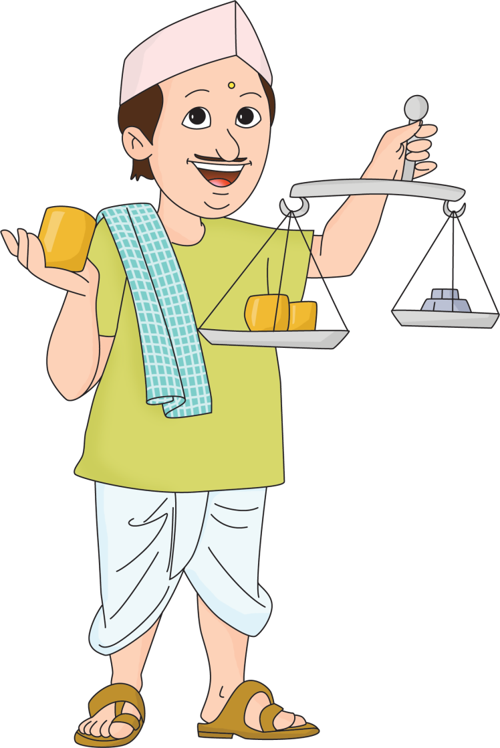
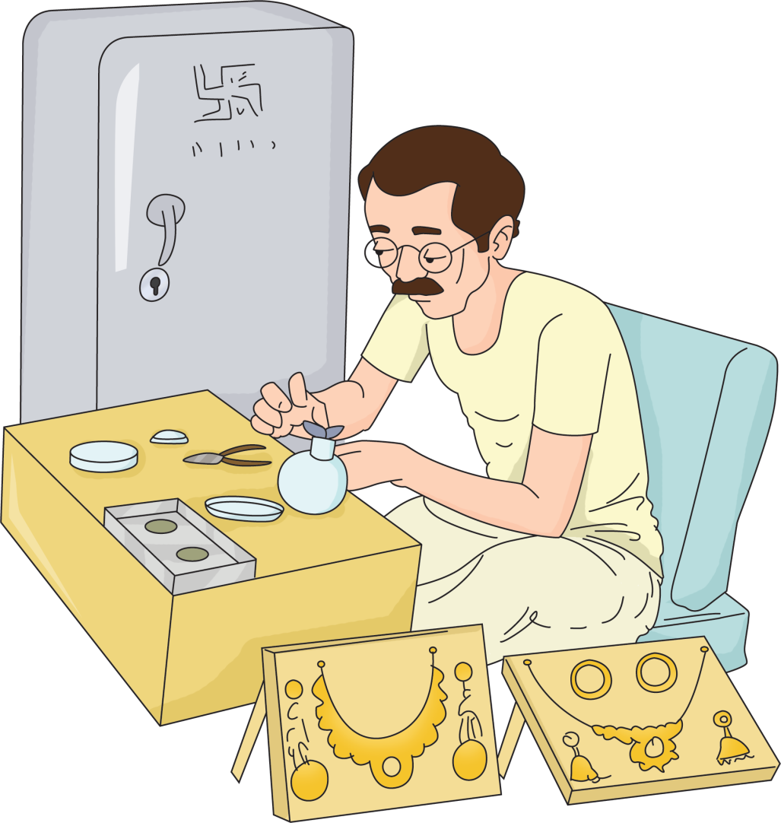
What happens at the end of the FD term?
I have decided to set up my own store. I need money immediately but my FD has not yet matured
It is Diwali and I have a lot of business! My FD has matured but I don’t need the money
My son has stood first in the university! I need money to visit him. My FD has matured.
If you need money urgently, you can close the FD and withdraw the money. But only if it is not a tax saving FD. This FD has a lock-in period of 5 years.
You might have to pay a penalty in any case!
Then you can RENEW the FD
And choose to reinvest the money you first invested and the interest you earned.
(This is called Compound Interest)
Then you can RENEW only the amount you first invested and withdraw the interest you earned

Slide 7




What is a Recurring Deposit?
A type of account where a fixed amount is invested regularly over a period of time
I have got an increment in my salary! Where should I invest the extra money that I will get every month?
Put the money into a recurring deposit every month. It will earn higher interest than a savings account

Slide 8
Which is better – FD or RD?
Both Fixed and Recurring Deposits give you interest on the money you invest
If you have a large sum of money to invest at one time, choose FD.
If you want to invest small sums of money regularly, choose RD
There are other schemes that you can invest in too. Watch our video on Investments to know more!

